Slide 1
Integrating Camera & PIR Sensor. Verifying Software on host system
By:- Group-4
Dixaben Shah

Slide 2
Contents
Wireless PIR sensor
Pin connection for PIR sensor
NRF24L01 RF transceiver
Connection of NRF24L01 & LPC2148
Pin diagram
Connecting LPC2148 and ESP32- Cam

Slide 3
Wireless Pir sensor
Arduino nano is main MCU for making PIR sensor wireless
Output pin of PIR sensor is connected with digital pin of Arduino nano
NRF24L01 is connected to Arduino nano through SPI1.
Pin 1 and Pin 2 of NRF24L01 are connected to ground and VCC respectively.
CE and CSN of NRF24L01 have connection with digital pins- 9 & 10.
CSK and MOSI are mounted on pin 13 & 11 of Arduino nano respectively.
Digital pin 12 is used to make connection with MISO.

Slide 4
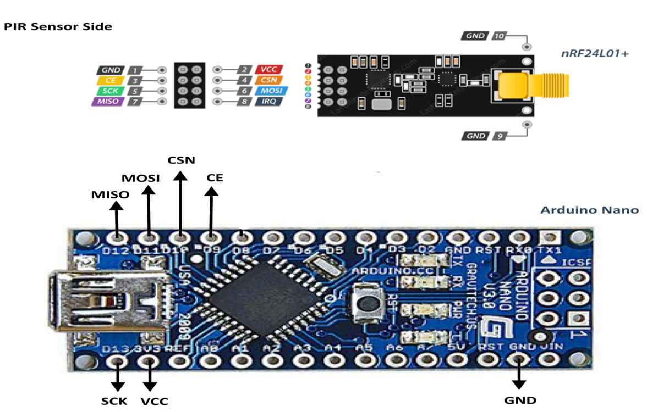
Pin connection for PIR sensor

Slide 5
NRF24L01 RF TRANSCEIVER
Role in the existing Project –
Transmits and receives data from PIR Sensor and LPC 2148 through radio frequency.
Ports to be used in interfacing –
CE - Chip enable(enables transmitter or receiving mode)
CSN – Chip select not pin
SCK – Serial clock for SPI communication
CLK – Clock
MISO – Master In serial out
MOSI – Master out serial in

Slide 6
Connection of NRF24L01 & LPC2148
NRF24L01 is connected with LPC 2148 through SPI 1 (Serial peripheral interface).
Two GPIO pins are used namely – CE and CSN.
1. CE is mounted on port 0 at pin 20.
2. CSN is connected on port 0 at pin 21.
SCK is connected with SPI 1 on pin 17.
Connection of MOSI and MISO is done with pin 19 and 18 respectively.

Slide 7
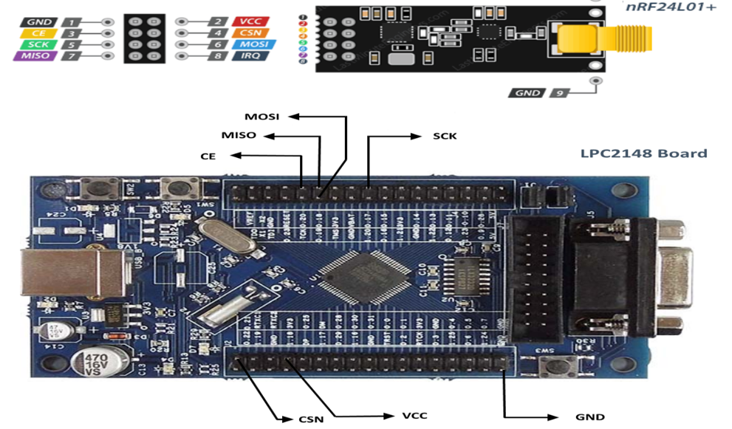
pin diagram

Slide 8
Connecting LPC 2148 and ESP32-CAM
Pin 7(Rx) of ESP 8266 is connected to pin 8 (port 0) of LPC 2148.
VCC of ESP 8266 is connected to 3.3V of LPC 2148.
Pin 2 (Tx) of ESP 8266 is connected to pin 9 of LPC on port 0.
Pin 1 is grounded with LPC 2148.

Slide 9
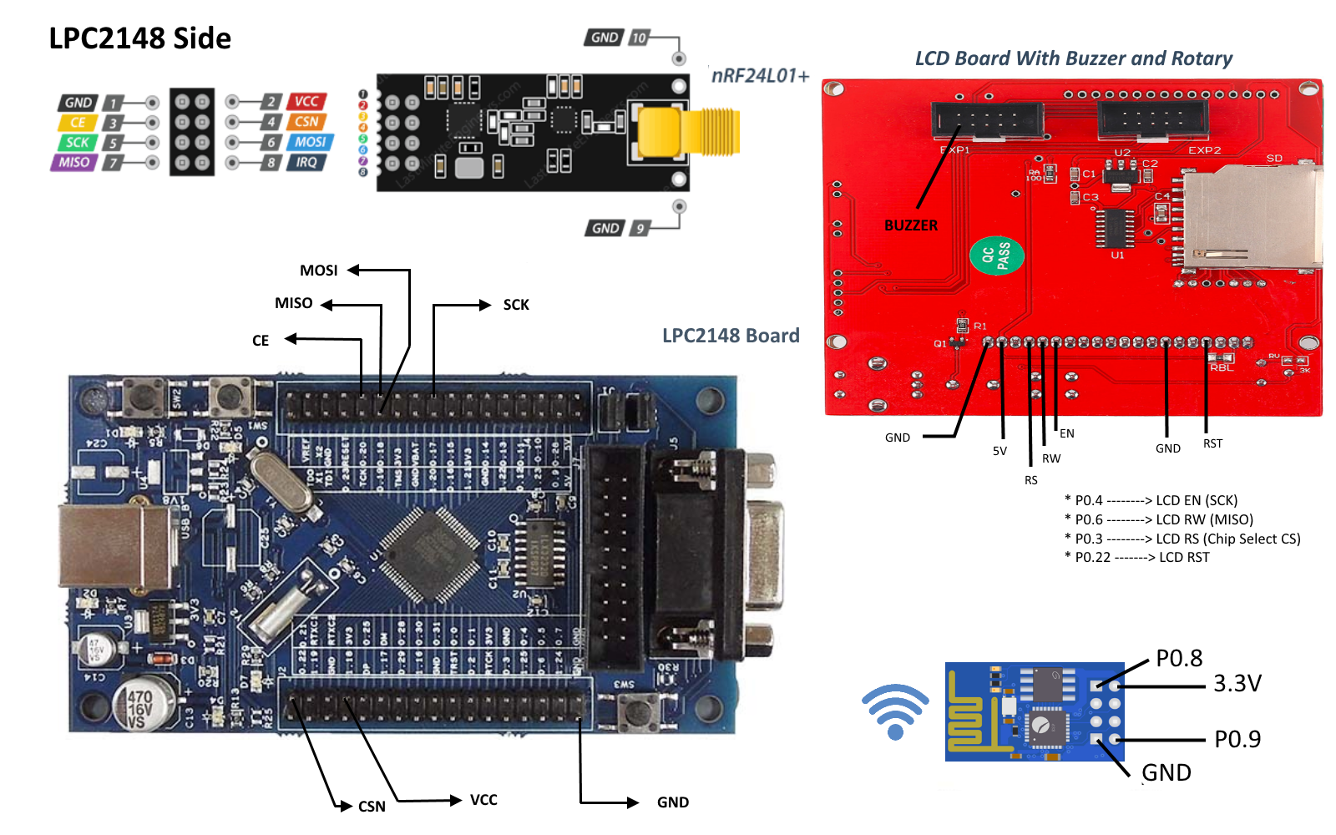
Connection diagram OF THE ENTIRE SYSTEM

Slide 10
references
Arduino nano and PIR sensor connection. Retrieved from:
https://randomnerdtutorials.com/arduino-with-pir-motion-sensor/
nRF24L01 Datasheet PDF. (n.d.). Retrieved from
https://www.sparkfun.com/datasheets/Components/SMD/nRF24L01Pluss_Preliminary_Product_Specification_v1_0.pdf
FreeRTOS Porting for LPC2148 Using Keil. (2018, November 15). Retrieved July 13, 2020, from
https://embetronicx.com/tutorials/rtos/freertos/freertos-porting-for-lpc2148-using-keil/
Pinout Configuration ESP8266. Retrieved from
https://components101.com/wireless/esp8266-pinout-configuration-features-datasheet

